Slide 1
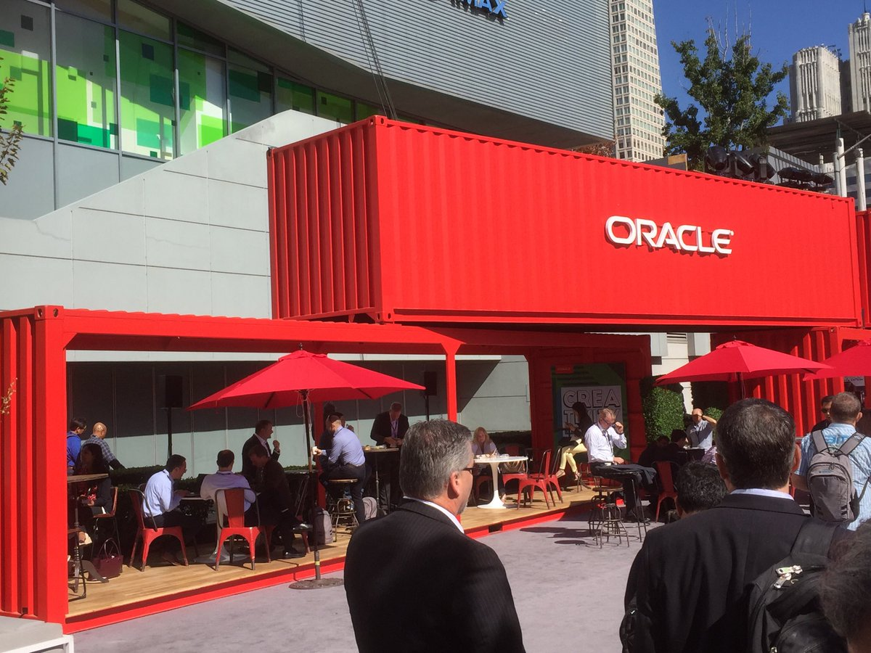

Implementing Microservices on Oracle Cloud: Open, Manageable, Polyglot, and Scalable
Lucas Jellema, CTO of AMIS
CodeOne 2018, San Francisco, USA
Notes:
The microservices architecture promises flexibility, scalability, and optimal use of compute resources.
Via independent components with well-defined scope and responsibility, interface, and ownership that are evolved and managed in an automated DevOps process, this architecture leverages current technologies and hard-learned insights from past decades.
This session demonstrates how to implement, roll out, and manage a set of collaborating microservices on Oracle Cloud, using services such as
container (Docker) and Oracle Application Container Cloud,
event hubs, Oracle Container Engine (Kubernetes),
Oracle Identity Cloud Service,
Oracle Data Hub Cloud Service,
Wercker, Oracle Visual Builder Cloud Service, and Fn serverless platform
and open source tools: Istio, Prometheus, Zipkin, Grafana.

Slide 2
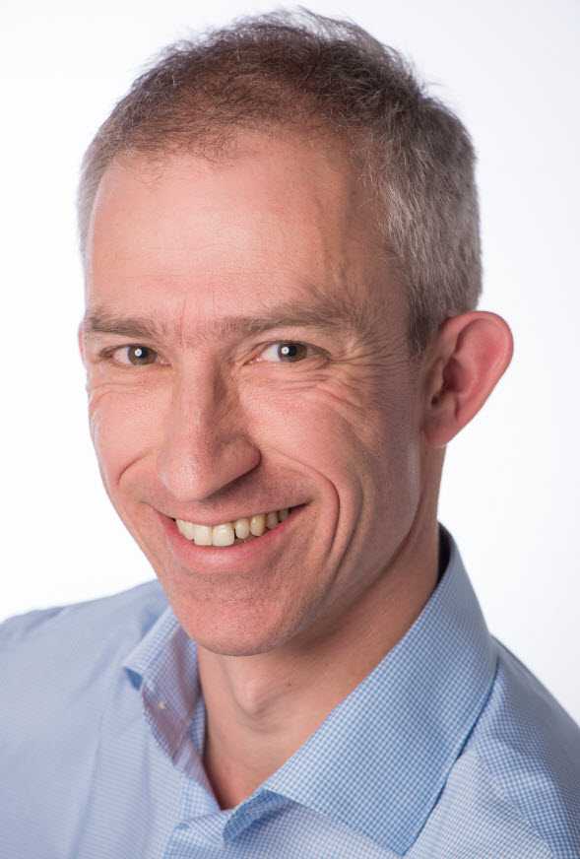
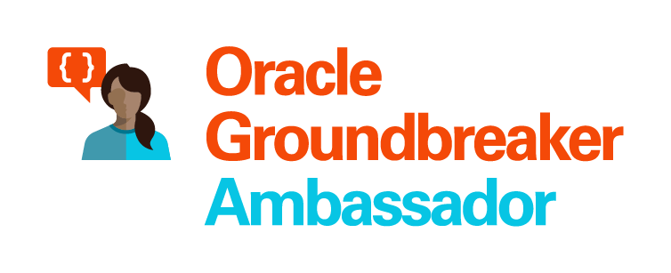


Lucas Jellema Architect / Developer 1994 started in IT at Oracle 2002 joined AMIS Currently CTO & Solution Architect

Slide 3
Overview
The challenge
Why and what of microservices
Implementing a microservice
The container artifact
Data
The microservices platform
Run one, Scale
Team up many
Ops on microservices
Route, throttle, authorize, scale
Monitor (end user experience, SLA), track & trace (flows & chains)
And what about the User Interface?
Serverless

Slide 4
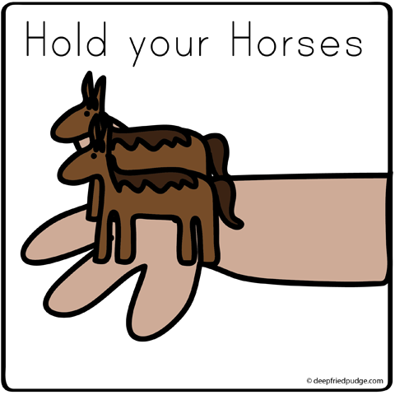
How do we implement microservices?
And how we make the containers horizontally scalable
How do we get from a Monolith to Microservices?

Slide 5
Why? What? How?
Notes:
Objectives
Requirements
Specifications

Slide 6
What is IT all about?
Production Runtime
Application

Slide 7
What is IT all about?
Production Runtime
Application
Platform

Slide 8
Objectives
Business Agility
In functionality: quick, cheap, effortless and risk free
IT Agility
In non-functionality: scale, resilience, infrastructure & location
Real working applications with rapid relevant evolution that run reliably

Slide 9
What is IT all about?
Production Runtime
Operations
Monitoring & Management
Application
Platform
Platform
Platform

Slide 10
Production Runtime is the Result of Preparation Runtime
Preparation Runtime
Production Runtime
Development
Operations
Monitoring & Management
Application
Application
Agile Design, Build, Test
Platform
Platform
CD

Slide 11
What?

Slide 12
One team has Agile responsibility through full lifecyle
Preparation Runtime
Production Runtime
Development
Operations
Monitoring & Management
Application
Application
Agile Design, Build, Test
Platform
Platform
CD

Slide 13
One team has Agile responsibility through full lifecyle
Preparation Runtime
Production Runtime
DevOps
Development
Operations
Monitoring & Management
Application
Application
Agile Design, Build, Test
Platform
Platform
CD
You build it, you run it, you fix it, you evolve

Slide 14
One team has Agile responsibility through full lifecyle
DevOps
Application
Application
Platform
Platform
You build it, you run it, you fix it, you evolve

Slide 15
DevOps team owns and runs one (or more) products
Application
Platform
Generic Infrastructure Platform for running DevOps Products
Floorspace, Power, Cooling, Storage, Compute
Monitoring, Management, Cache, Authentication, RDBMS, Event Hub

Slide 16
Multiple products from multiple teams run on a shared generic infrastructure
Application
Application
Application
Application
Application
Platform
Platform
Platform
Platform
Platform
Generic Infrastructure Platform for running DevOps Products
Floorspace, Power, Cooling, Storage, Compute
Monitoring, Management, Cache, Authentication, RDBMS, Event Hub

Slide 17
(Application plus platform)under DevOps ==
µ
µ
µ
µ
µ
Generic Infrastructure Platform for running DevOps Products
Microservice

Slide 18

What?
Realistic approach (technology, people, process) => Something that works!
No dependency on individuals
Able to scale in rate of change
Small, well: comprehensible, manageable
Clear business ownership
Stand alone /isolated/encapsulated (in terms of change, release/deploy, scale, location, implementation technology)
Provide clear and meaningful functionality in a way that it can be consumed
One microservice does not completely fall over when other microservices break (or are redeployed)
Able to scale elastically & horizontally and relocate easily
A microservice exists within a single bounded context
Multiple microservices can share the same bounded context

Slide 19
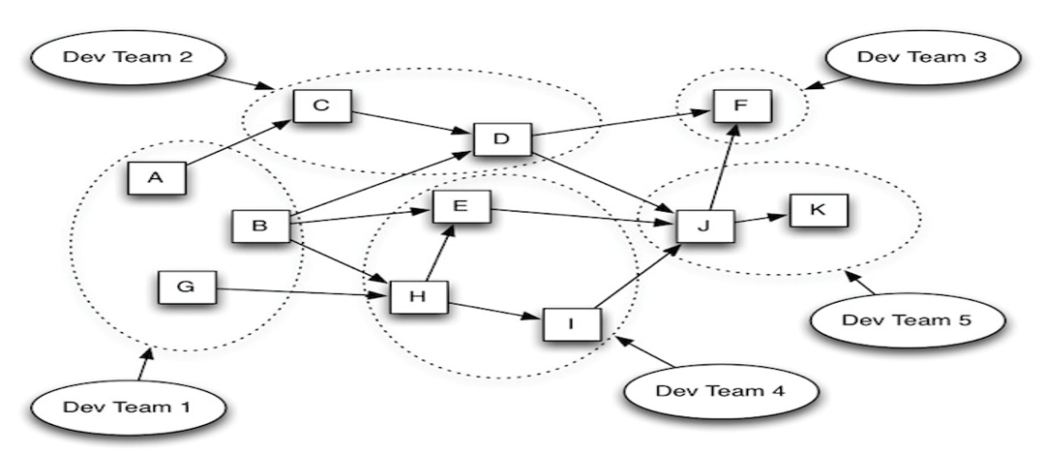
Microservices Architecture
Bounded Context or Domain, Team Ownership, Loose dependencies outside domains, independently (re)deployable components

Slide 20
scale
own
test
monitor
deploy
organize
manage
scale
scale
own
test
monitor
own
test
monitor
organize
deploy
organize
deploy
manage
scale
manage
µ
own
test
monitor
organize
deploy
µ
µ
manage
µ
own
test
scale
vs.
scale
organize
deploy
monitor
own
test
monitor
µ
manage
own
test
scale
own
test
scale
organize
deploy
deploy
monitor
organize
deploy
monitor
µ
manage
organize
manage
µ
manage
µ
own
test
scale
organize
deploy
monitor
own
test
scale
µ
manage
organize
deploy
monitor
µ
manage

Slide 21
µ
µ
[mini] µonolith
µ
µ

Slide 22
Owned by Business Manager X
High Change Rate
Highly Available
Needs to scale up to 10x between 7-10PM
Can be done by team of 5
µ
µ
Owned by Business Manager Y
Business Hours availability
Some Highly Secure Data
Fairly constant load
Very strict QA steps in CI/CD process
Can be done by team of 3

Slide 23
Webshop
Web Shop Portal
Backend
Notes:
dazzle the audience with a quick dump of all technologies (and cloud services) used for putting the webshop together - for the UI, the API implementation, the datastores and the event bus.

Slide 24
Microservices based Webshop
Web Shop Portal
µ Customers
µ Orders
µ Products
µ Loyalty
µ Finance
µ Logistics
µ Customers
µ Orders
µ Products
µ Loyalty
µ Finance
Notes:
dazzle the audience with a quick dump of all technologies (and cloud services) used for putting the webshop together - for the UI, the API implementation, the datastores and the event bus.

Slide 25
Warehousing
µ Logistics
µ
Shipping

Slide 26
How?

Slide 27
How microservices
One team owns the microservice and can do functional and technical evolution and deployment continuously and independently
The business ownership is clearly defined
Application
Platform

Slide 28
The Microservice
HTTP REST/JSON
API

Slide 29
Extended API of microservice
API
Deployment API
Injectable dependencies – reference to cache, logging, storage URL, …
Configurable meta-data – run time parameters, log level, credential (key)
Interaction API
REST Resources & Operations – query and URL parameters, message formats
Events Consumed – alternative way to call | activate a microservice
Reference to entry in Event Catalog
May include reference to shared Cache Resource
Events Produced – alternative output from microservice
Event can be an asynchronous response to a stateless consumer

Slide 30

How microservices: design & implement
Business & Team ownership of application and associated platform
Automated CD – including regression test
Open (standards, protocols) on the outside, whatever you like inside
Deployable on enterprise standardized microservices platform
API & Event
Standard protocols for interaction
Horizontally scalable: multiple parallel instances
Stateless instances – horizontally scalable up & down, can handle fail over & restart
Private Bounded (Data) Context
Including derived data from other domains

Slide 31
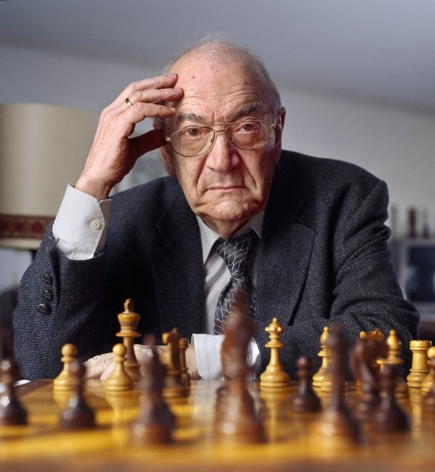
Notes:
Viktor Korchnoi – Stateless Chessplayer

Slide 32
Microservices State
Generic Platform for running microservices
LDAP
Big Data
Block Storage
Cache
RDBMS
NoSQL
Document Store
Event Hub
Notes:
All data stores are distributed
Or at least distributedly available
They can be local or on cloud (latency is important)
Data in generic data store is still owned by only one microservice – no one can touch it
Only in DWH and BigData do we deliberately take copies of data and disown them

Slide 33
Bounded context in microservices
A micoservice needs to be able to run independently
It needs to contain & own all data required to run
It cannot depend on other microservices
UI
API
Customer
API
Order
CustomerModified event

Slide 34
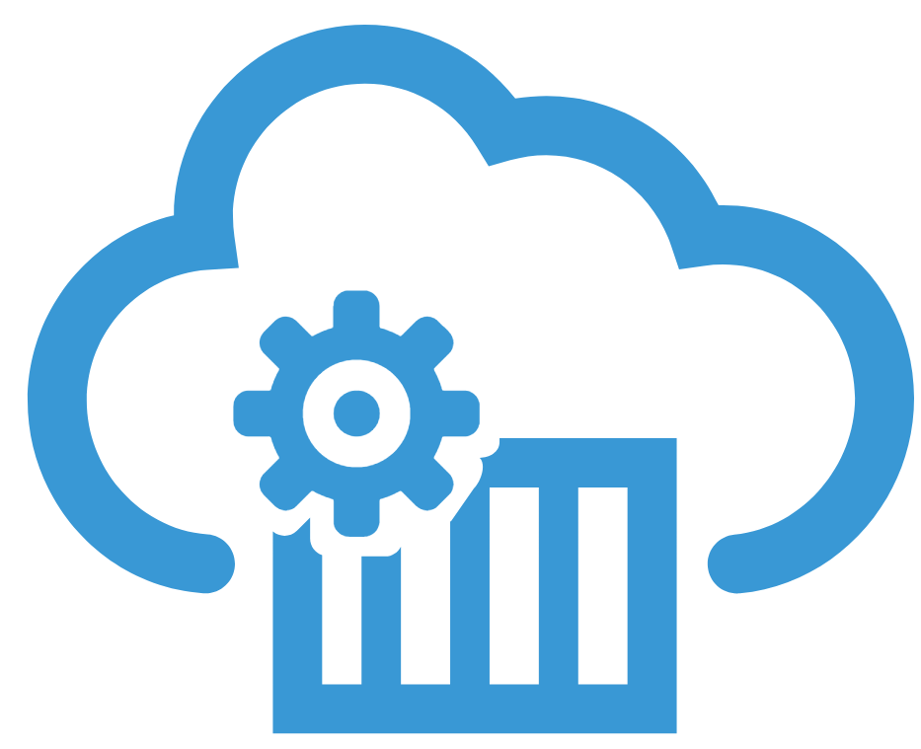
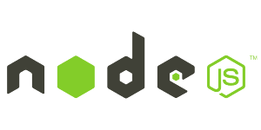

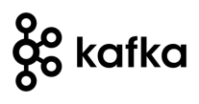




Demo – Maintaining Derived Data in Bounded Context
Customer Microservice
Order Microservice
Customer Modified Event
Application Container
Application Container
Event Hub
Customers
Topic
DBaaS

Slide 35
Microservices based Webshop
Web Shop Portal
µ Customers
µ Orders
µ Products
µ Loyalty
µ Finance
µ Logistics
µ Customers
µ Orders
µ Products
µ Loyalty
µ Finance
Notes:
dazzle the audience with a quick dump of all technologies (and cloud services) used for putting the webshop together - for the UI, the API implementation, the datastores and the event bus.

Slide 36



…. Event-(First) Driven
Event Monitor
Product Update
Product added to Shopping Cart
Shop
Products
Event Hub
Topic X
Topic Y
Topic Z
Topic Q
New Customer
Customer Profile Changed
Customer Sign In
Customers
Order Payment Received
Customer Frozen
Customer Loyalty Status Change
Order Create
Order Cancelled
Product Stock Update
Shipping News
Loyalty Program
Order
Logistics
Finance

Slide 37

API Gateway
Many other consumers
API Portal
Web Shop Portal
µ Customers
µ Orders
µ Products
µ Loyalty
µ Finance
API Platform

Slide 38



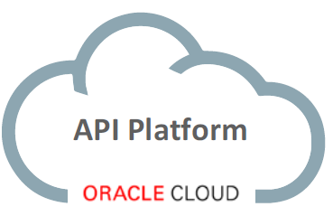
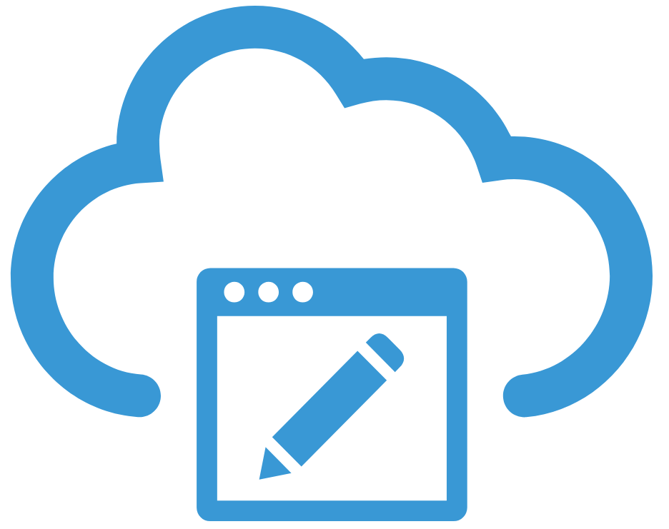
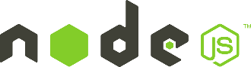

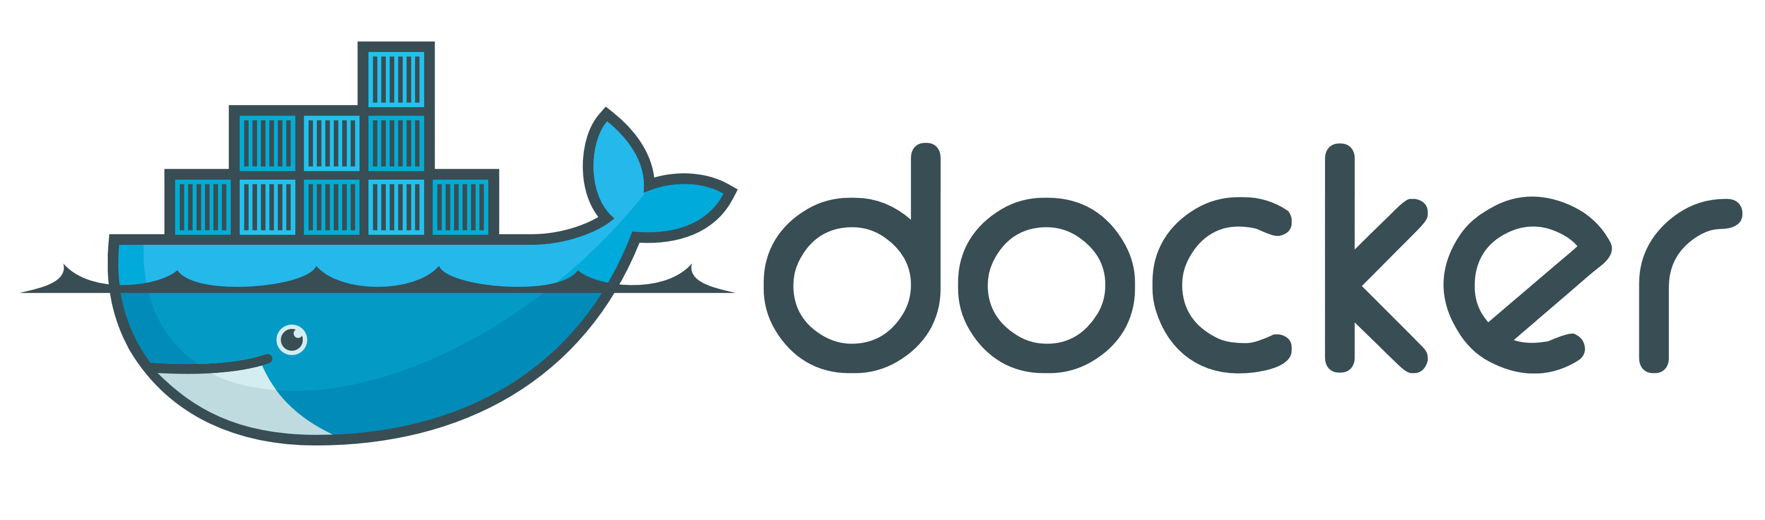
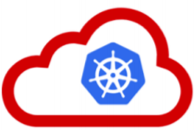


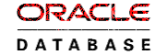
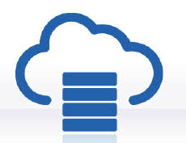
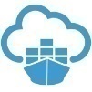



API Portal
Web Shop Portal
µ Customers
µ Orders
µ Products
µ Loyalty
µ Finance
API Platform
Backoffice UI
λ
Event Schema Registry
Event Hub
Notes:
dazzle the audience with a quick dump of all technologies (and cloud services) used for putting the webshop together - for the UI, the API implementation, the datastores and the event bus.

Slide 39
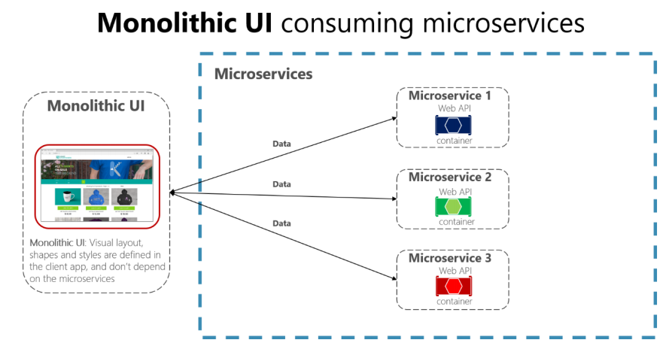
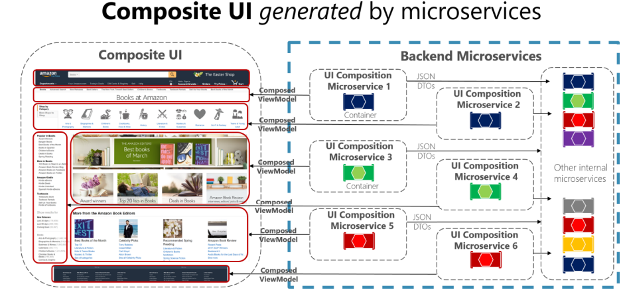
Microservices Architecture - User Interface
Is UI part of Microservice?
VS.
Notes:
spend a little time on microservices - why decided to apply a microservices architecture (objectives, expectations) and how we designed the architecture in our case (link to Omesa?). What were the rules and assumptions. Here we can perhaps show how we use Slack and GitHubExplain in some details what important role events played. Maybe at that point also discuss the workflow (@Luis Weir’s article and our discussions around that).Perhaps we can use the Event Monitor Dashboard (that shows all on EventHub/Kafka events on a timeline ) to illustrate the story on the events (and the Order workflow)

Slide 40
User Interface in a Microservices architecture
Web Shop Portal
µ Customers
µ Orders
µ Products
µ Loyalty
µ Finance
µ Logistics
µ Customers
µ Orders
µ Products
µ Loyalty
µ Finance

Slide 41
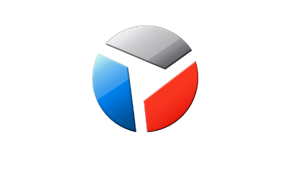
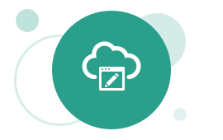

Web Shop Portal Solution Design – decoupled IFRAME based microservice front-ends
Web Shop – Customer User Interface
CustomerSignIn,
ChangedProfileSettings
Client Side (JS) Event Bus & Routing
Context (user settings, navigation history, ..)
Menu & Nav
Marketing content
IFRAME
IFRAME
ViewProduct
InspectInvoice
IFRAME
IFRAME
IFRAME
AddToBasket
API Gateway
µ Customers
µ Orders
µ Products
µ Loyalty
µ Billing & Invoicing

Slide 42
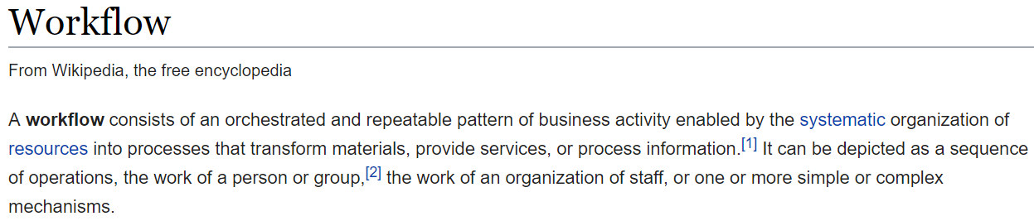
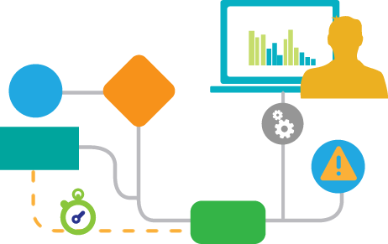
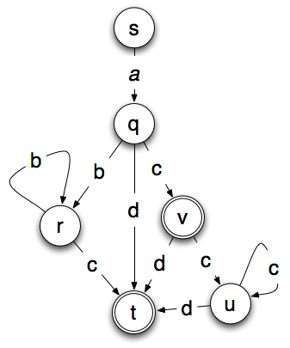
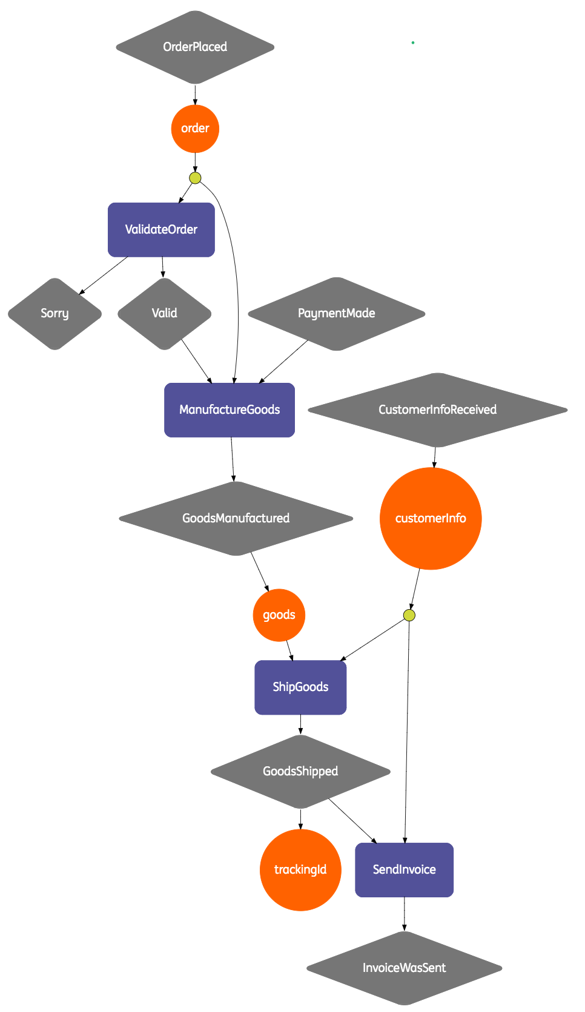
Defining Workflow
Cross domain cutting concern
Composite transaction
Multi-step chain
Long running process
System initiated human participation
For example: the order flow
Submit order, check availability, collect payment, organize picking and shipping, and update loyalty status

Slide 43
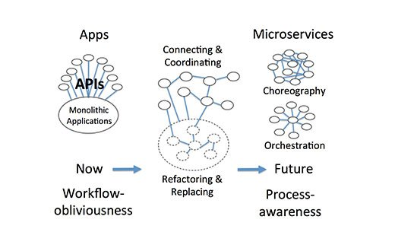
Approaches
Orchestration
Choreography
Hybrid
Coordinated | Facilitated Choreography
Mixing orchestration and choreography

Slide 44

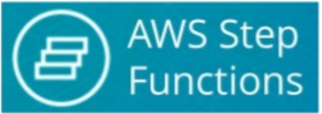


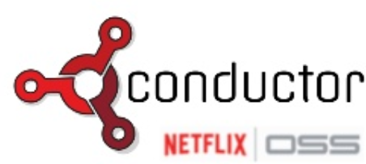
Cross Domain Workflows Orchestration is allowed within, choreography across
Workflow Definitions
Workflow & Task Metrics
Facilitated Choreography
Task Queue/Dispatcher
Workflow Instance State
Proxy
Actor
Facilitated Choreography
Orchestrator
Orchestrator
µ
λ
µ
µ
µ
µ
λ

Slide 45
How? Run & Operate

Slide 46
Run & Operate Microservices
µ
µ
µ
µ
µ
Rapid rollout
Including scale out & recover
Non breaking upgrade & rollback strategies (e.g. canary release)
Agile infrastructure
Relocate, independent of infra specifics
Health management
Monitor and safeguard SLA requirements on response time, success and availability
Scale elastically
TCO management
DevOps: one team creates and runs
Generic Infrastructure Platform for running DevOps Products

Slide 47


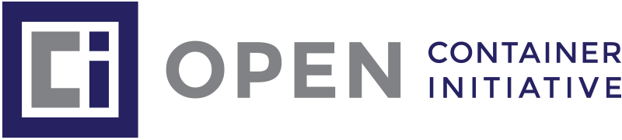
The elephant in the room…
whale

Slide 48
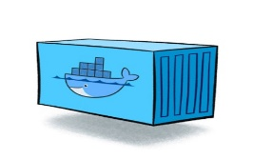
Containers
As vehicle for:
Encapsulate
Build
Share & Ship
Automated Tests
Deploy
Run
Scale
Relocate
Standardize

Slide 49
Looking for a runtime platform for
Compute Node
Notes:
Deploy and Run (Docker Containers)
Distributed infrastructure (scalable and available)
Hide infrastructure from DevOps teams
Auto-healing
Elastic Scale
Wire up the micros – connect dynamically (service discovery)
Load Balance
Provide Persistent storage
Rolling Upgrade
Configuration & Secret Management
Secure

Slide 50
Looking for a runtime platform for
Compute Node
Compute Node
Compute Node
Notes:
Deploy and Run (Docker Containers)
Distributed infrastructure (scalable and available)
Hide infrastructure from DevOps teams
Auto-healing
Elastic Scale
Wire up the micros – connect dynamically (service discovery)
Load Balance
Provide Persistent storage
Rolling Upgrade
Configuration & Secret Management
Secure

Slide 51
Looking for a runtime platform for
Compute Node
Compute Node
Compute Node
Notes:
Deploy and Run (Docker Containers)
Distributed infrastructure (scalable and available)
Hide infrastructure from DevOps teams
Auto-healing
Elastic Scale
Wire up the micros – connect dynamically (service discovery)
Load Balance
Provide Persistent storage
Rolling Upgrade
Configuration & Secret Management
Secure

Slide 52
Looking for a runtime platform for
Compute Node
Compute Node
Compute Node

Slide 53
Looking for a runtime platform for
Compute Node
Compute Node
Compute Node

Slide 54
Looking for a runtime platform for
Compute Node
Compute Node
Compute Node
Cloud Storage
SAN

Slide 55
Looking for a runtime platform for
Configuration Map
Configuration Map
Compute Node
Compute Node
Compute Node
Cloud Storage
SAN

Slide 56

Looking for a runtime platform for
Compute Node
Compute Node
Compute Node

Slide 57
Looking for a runtime platform for
Compute Node
Compute Node
Compute Node
Compute Node
Compute Node

Slide 58
Looking for a runtime platform for
Compute Node
Compute Node
Compute Node

Slide 59
Looking for a runtime platform for
v2
v2
v2
Compute Node
v2
v2
Compute Node
Compute Node

Slide 60
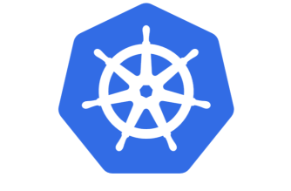

Slide 61
Introducing Kubernetes
Distributed Container Run Time Management platform
Based on Google’s Borg system (in use at Google for over a decade)
Initial announcement: 2014
Kubernetes v1.0 was released on July 21, 2015
A Kubernetes cluster typically spans multiple compute nodes
Either in the cloud, on premises, on a single machine (minikube) or hybrid
K8S manages Pods in which containers are running
K8S schedules Pods on one or more nodes
Docker can be the container runtime; other engines are supported as well, such as rkt and containerd
K8S handles network traffic to, between and from Pods
The kubectl command line interface is used for most management activities

Slide 62
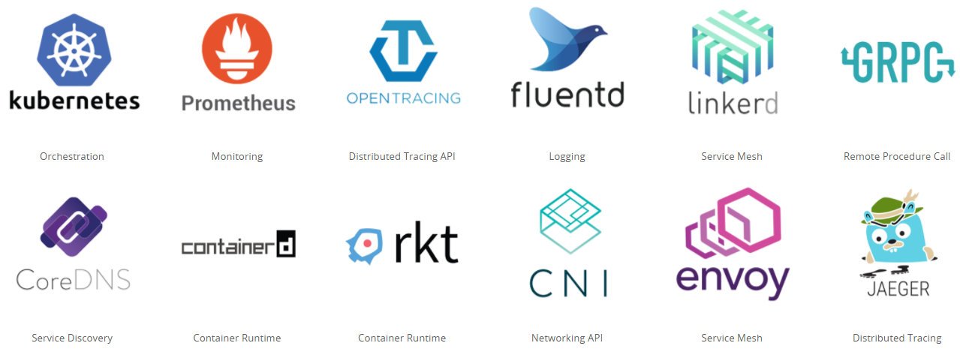
Cloud Native & Vendor Neutral
Cloud Native Computing Foundation - CNCF
Oracle is a platinum member since July 2017
Cloud Native: container packaged, dynamically managed, microservices oriented
Open technology for running container based workloads in a cross cloud vendor neutral way
Notes:
https://www.cncf.io/

Slide 63
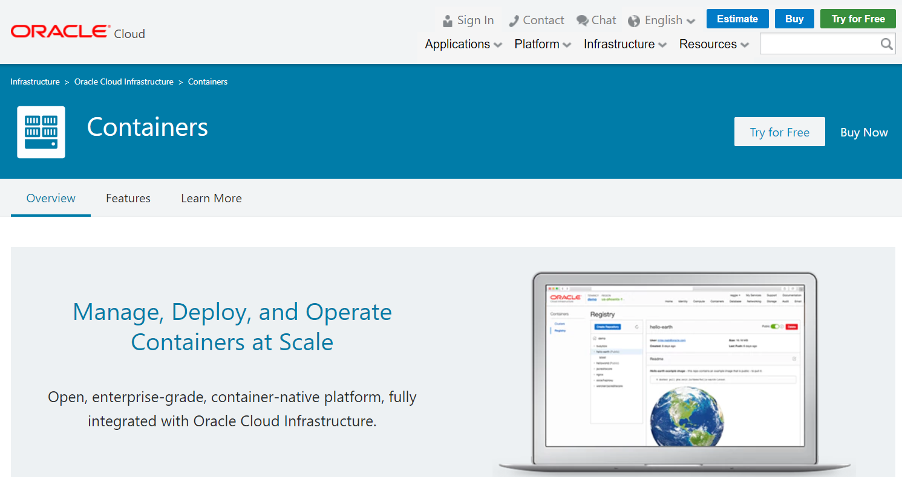
OKE – Oracle Kubernetes Engine (launched May 2018)

Slide 64
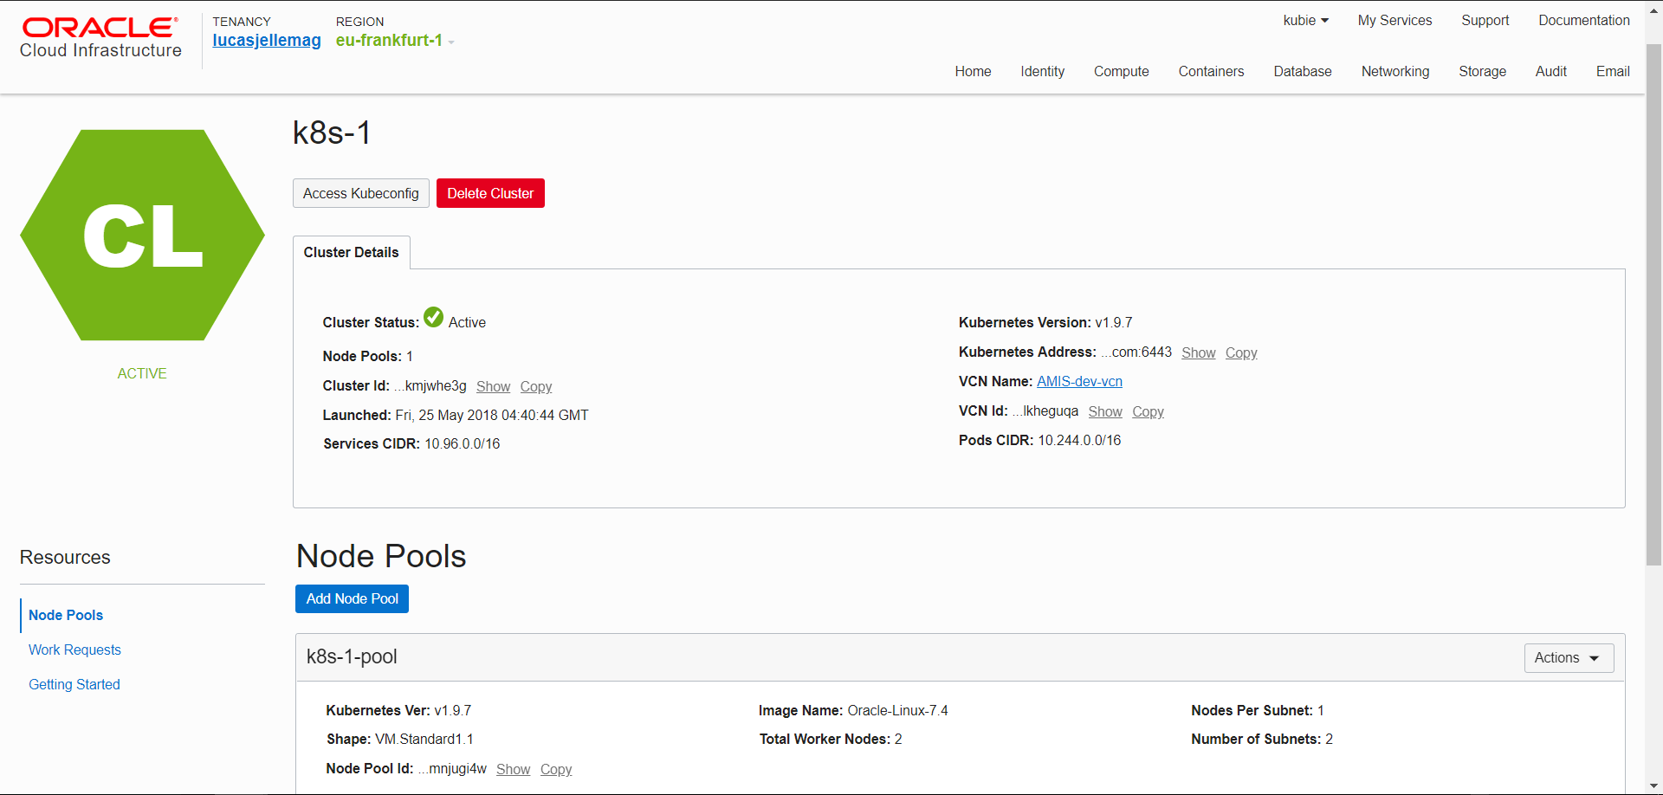

Slide 65
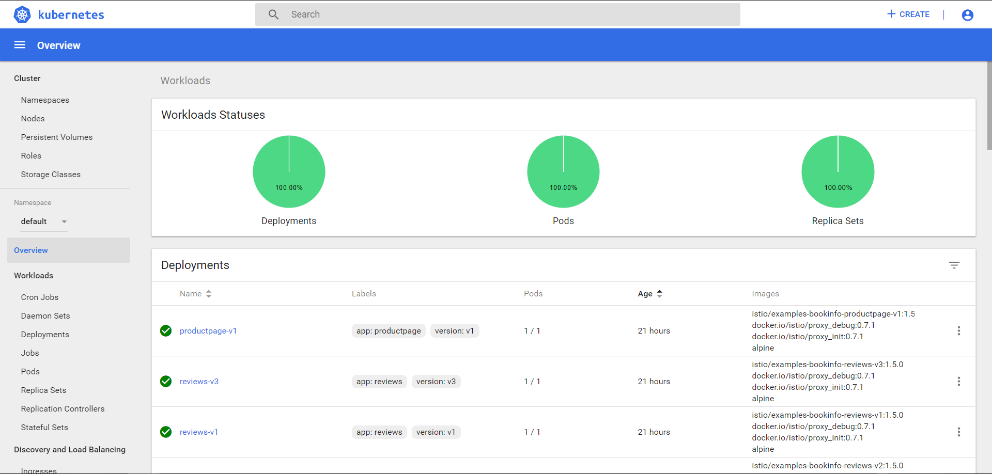

Slide 66
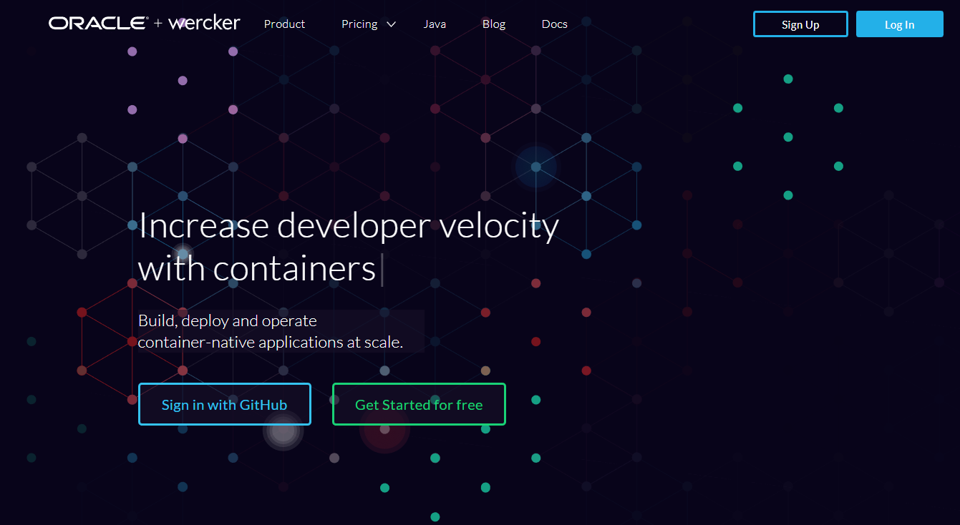
Automated Container [Build | Stock | Deliver] Pipelines
Oracle Wercker [aka Oracle Container Pipelines Cloud]

Slide 67
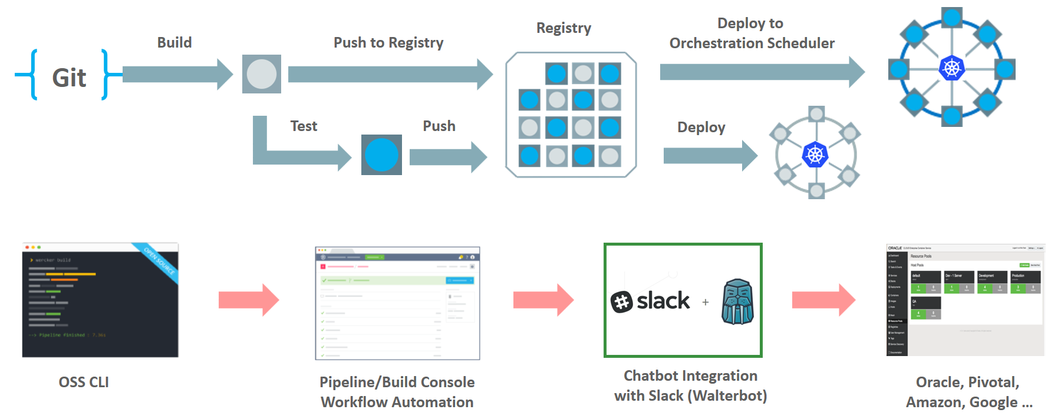
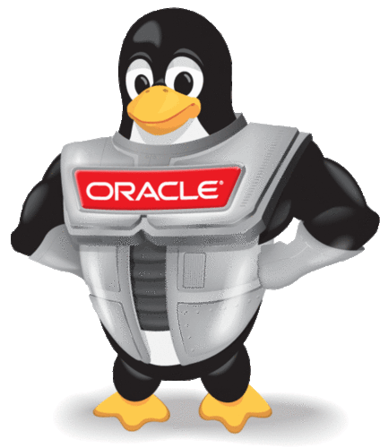
Wercker: Build, Test, Push and Deploy Pipelines for Containers
µ
µ
µ

Slide 68
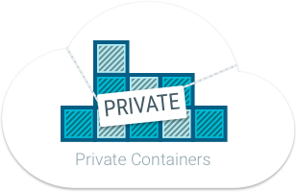
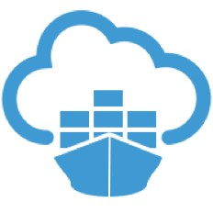

Oracle Container Registry for Your Images
After build and before run – container images need to be stored
Secure (because runtime artefacts)
Accessible (& low latency) to deployment engine and container runtime
Scalable and Smart (no duplicate images and image layers)
Notes:
https://docs.us-phoenix-1.oraclecloud.com/Content/Registry/Concepts/registryoverview.htm?Highlight=registry

Slide 69
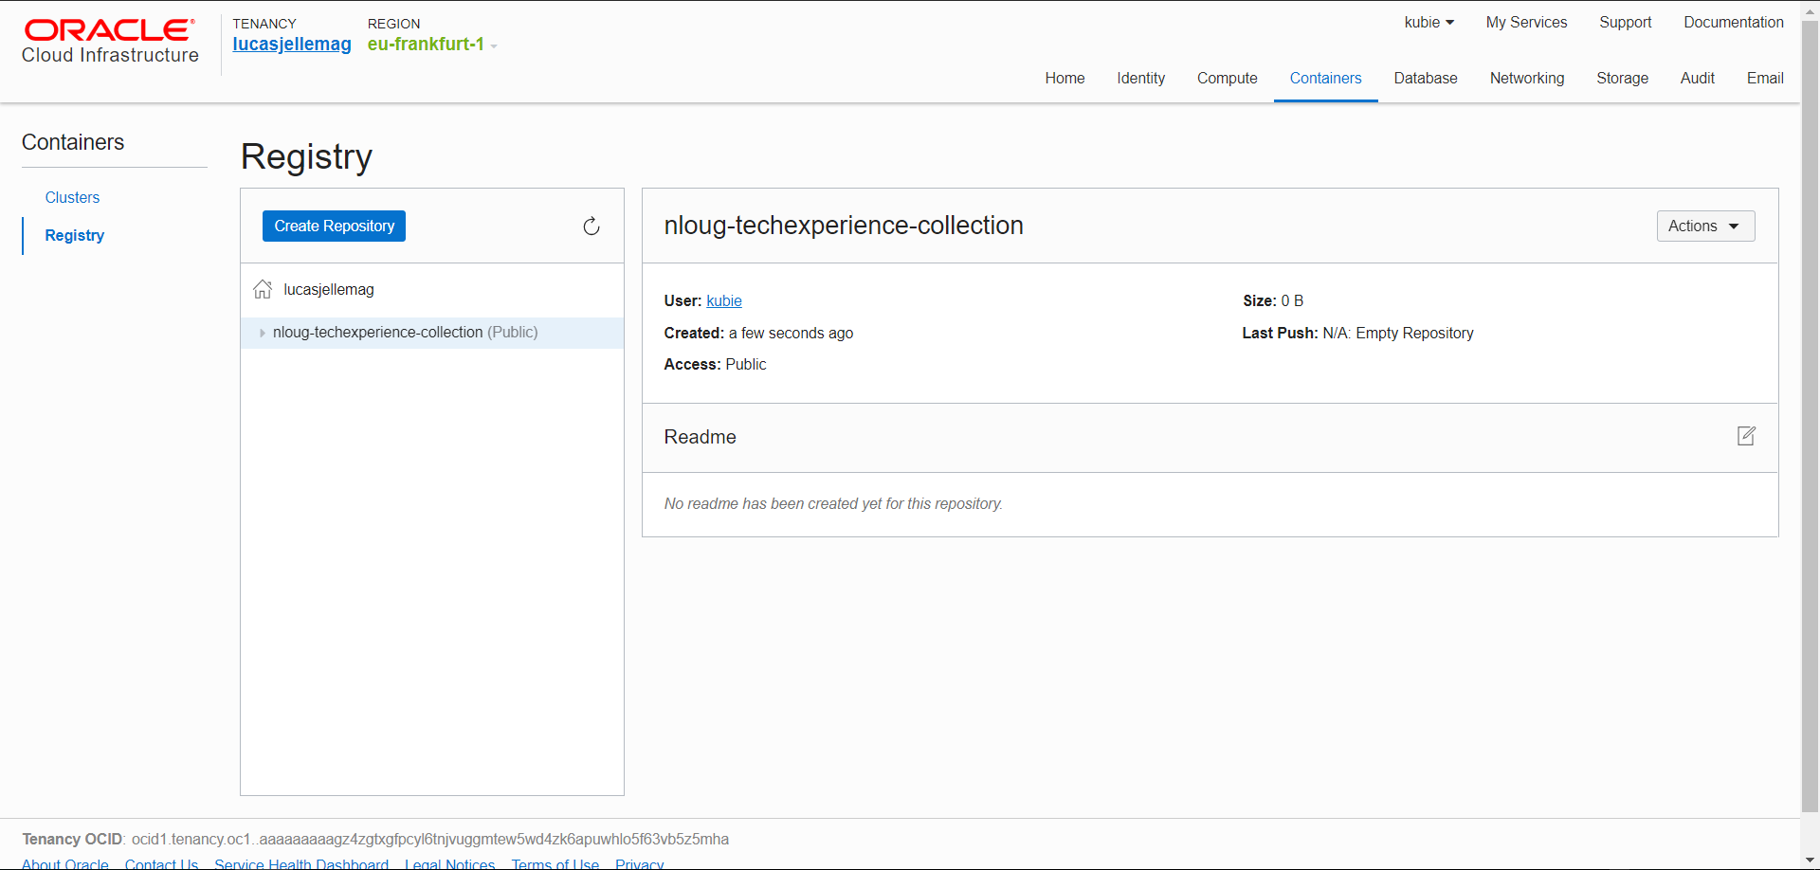

Slide 70
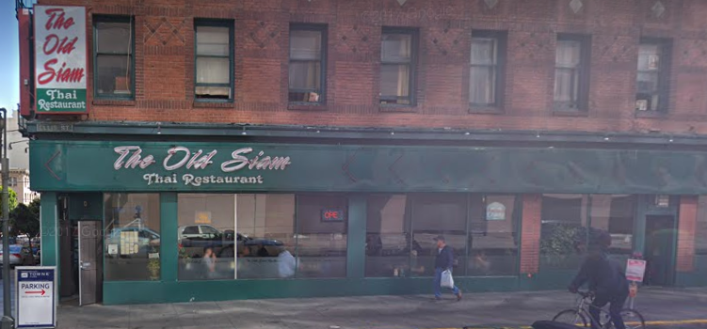
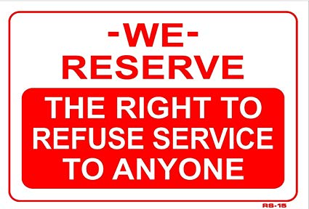
The Old Siam Thai Restaurant

Slide 71
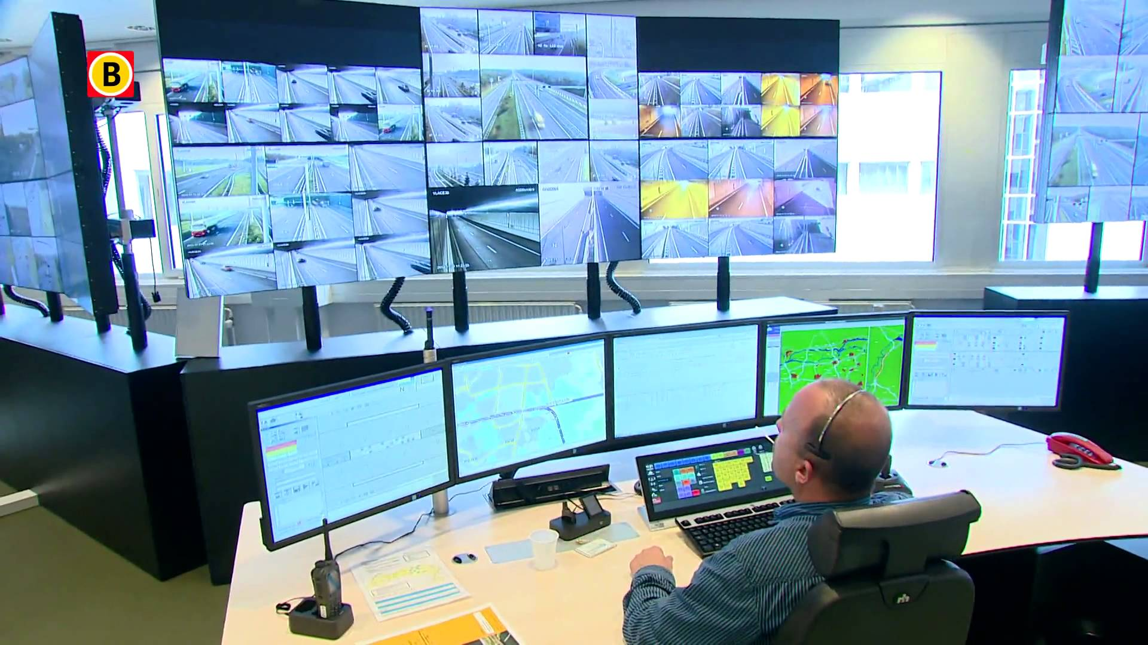

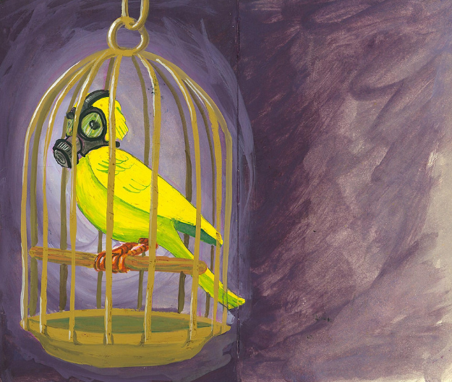
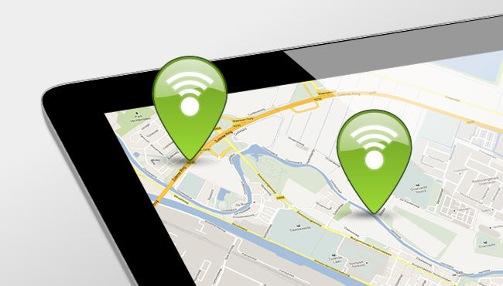
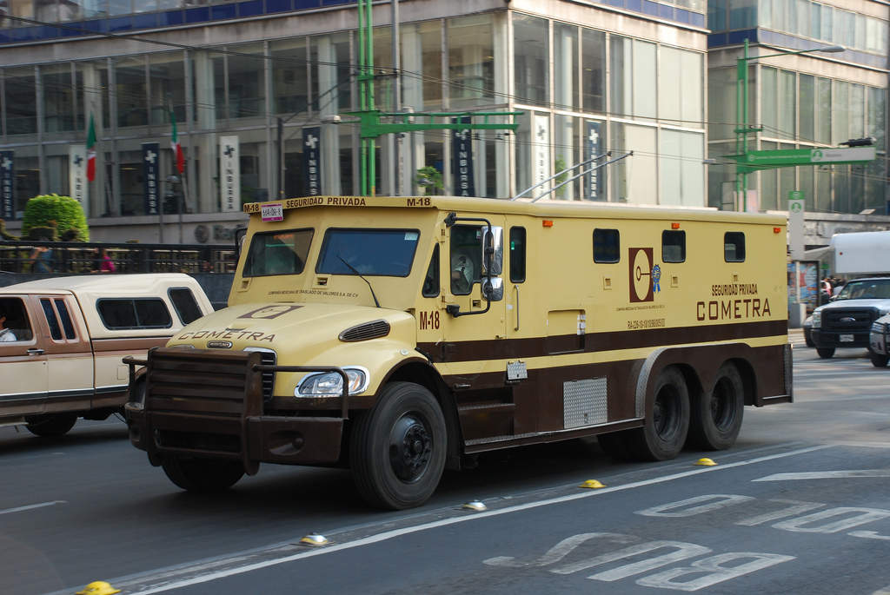



Microservice Runtime Platform - plus
Notes:
Monitor
Health
Load/performance
Tracing
Collect metrics & logs for analysis
Route
A/B, Canary, Authorize/Policy Enforcement, Protocols
Circuit Breaker, Throttle (Rate Limiting)
Mirror traffic for asynchronous testing
Security
TLS
Access control – whitelist/blacklist,

Slide 72


Slide 73






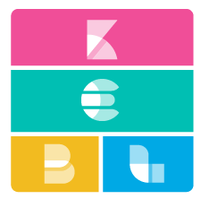


Istio – Service Mesh Operations
Routing
Access Control
Whitelist/Blacklist
Security
TLS
Resilience
Rate Limiting & Circuit Breaker
Monitoring
Trace
Service Graph

Slide 74
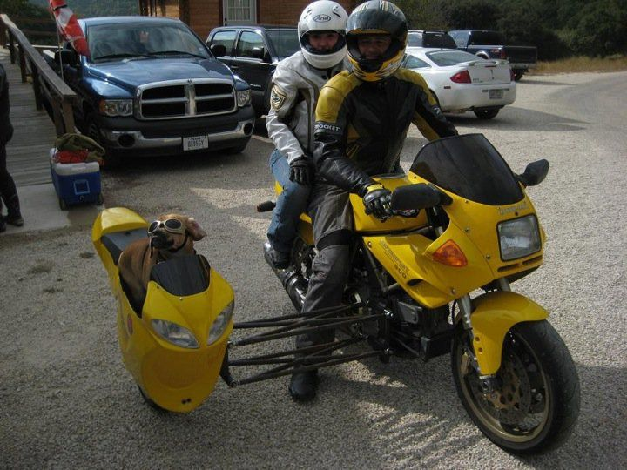
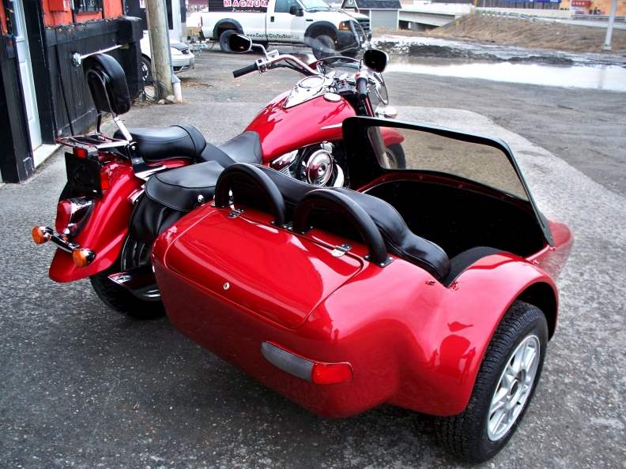

Slide 75
Envoy Sidecar
http(s), tcp,gRPC
Pod
Envoy Sidecar
Metrics, trace, policy checks
Istio Mixer
Configuration
Istio Pilot
TLS Certificates
Istio Auth
Notes:
Docker container
Injected into Pod
Handles all inbound/outbound traffic
Guided by Pilot
Reporting to Mixer

Slide 76












Microservices Platform (Kubernetes & Istio) ++
API Gateway
Cache
Event Hub
Service Broker
Chaos Monkey & Regression Testing
Workflow
Transactions (cross microservice)
RDBMS, NoSQL, Data Lake(Big Data), Fast Data Ingestion
Billing
Notification
Microservices Platform
Storage

Slide 77




Oracle Cloud & Container Native Microservices Architecture – Fall 2017
µ
Foo2
Voice Recognition
API Registry
Event Management
Open Service Broker
Billing Engine
ISTIO
Diagnostics/Monitoring
Prometheus
Developer Cloud
ISTIO
ISTIO
Managed Kubernetes
Block Storage
Cache
RDBMS
LDAP/IdM
NoSQL

Slide 78
Oracle Cloud & Container Native Microservices Architecture – as per February 2018
<intentionally left blank>

Slide 79

Oracle Cloud & Container Native Microservices Architecture – October 2018
Built on OKE and OCI Registry, leverages industry standards, open source tooling
Enables easy and flexible extensions to create a complete, customized stack
Cluster add-ons for in-cluster extensions
Integrated end-to-end security
Policy management, scanning, auditing, auth
Full visibility
ELK, Prometheus, Grafana
Service Brokers / Catalog
Integrate container based apps with a wide range of OCI cloud services
Notes:
Beyond Kubernetes - A "Container Native Platform"
Built on OKE and OCI Registry, leverages industry standards, open source tooling
Enables easy and flexible extensions to create a complete, customized stack
F — Cluster add-ons for in-cluster extensions
’ Integrated end-to-end security - Policy management, scanning, auditing, auth
Full visibility
- ELK, Prometheus, Grafana
Service Brokers / Catalog
- Integrate container based apps with a wide range of OCI cloud services

Slide 80

Oracle Cloud & Container Native Microservices Architecture – October 2018
Notes:
Beyond Kubernetes - A "Container Native Platform"
Built on OKE and OCI Registry, leverages industry standards, open source tooling
Enables easy and flexible extensions to create a complete, customized stack
F — Cluster add-ons for in-cluster extensions
’ Integrated end-to-end security - Policy management, scanning, auditing, auth
Full visibility
- ELK, Prometheus, Grafana
Service Brokers / Catalog
- Integrate container based apps with a wide range of OCI cloud services

Slide 81

Kubernetes Platform Services on OKE
Notes:
Initiatives in the initial phase
Helm Workflow Manager
Enhanced industrial strength Workflow Manager complementing OKE cluster lifecycle
Foundational component for MPK
Service Catalog
In Cluster Service Catalog and OSB based Service Broker enabling binding OCI Services
Add on Store
Integration with OCI Marketplace for Add Ons enabling installing OSS components on OKE
Managed Istio / Istio via Add Ons catalog
Out of the box support for Istio on OKE clusters
Available as a Add On in the short term
Telemetry and Logging - Sauron
Container Native integration for Prometheus and ELK stack ( CNCF tools
Helm Workflow Manager
Drive the installation and management of components to an OKE cluster
Reliable workflow based on Helm
Enable installation of components during cluster creation as well additional components from the Add On store on an existing cluster
Foundational component for
Istio,
Service Broker
Event Broker
Extend the OCI Market place to host OSS components which are Kubernetes native
Enables applications to use components that are not yet available as managed services
E.g. Caching layer, OSS queuing layer
Integrate with Helm Workflow Manager to deploy and manage these components on OKE
Extend the Market place UI

Slide 82
Oracle Cloud & Container Native Microservices Architecture – October 2018
Built on OKE and OCI Registry, leverages industry standards, open source tooling
Enables easy and flexible extensions to create a complete, customized stack
Cluster add-ons for in-cluster extensions
Integrated end-to-end security - Policy management, scanning, auditing, auth
Full visibility
- ELK, Prometheus, Grafana
Service Brokers / Catalog
- Integrate container based apps with a wide range of OCI cloud services
Notes:
Beyond Kubernetes - A "Container Native Platform"
Built on OKE and OCI Registry, leverages industry standards, open source tooling
Enables easy and flexible extensions to create a complete, customized stack
F — Cluster add-ons for in-cluster extensions
’ Integrated end-to-end security - Policy management, scanning, auditing, auth
Full visibility
- ELK, Prometheus, Grafana
Service Brokers / Catalog
- Integrate container based apps with a wide range of OCI cloud services

Slide 83

Serverless
λ
λ
λ
λ
λ
λ
λ
λ
λ
λ
λ
µ

Slide 84


Open Source Serverless Function Platform
Functions can be implemented in any language
Java, Go, PHP, JavaScript/Node, Python, Ruby
Functions run in their own container
Functions can be accessed via HTTP calls
Routing, load balancing, running is taken care of by Fn Server platform
Platform runs locally, on prem & in cloud
Fn Flow orchestrates workflows across multiple functions
Workflow described in Java
Includes business logic (conditional, parallel execution, exceptions)
µ
Notes:
https://blogs.oracle.com/developers/kubecon-europe-2018-oracle-open-serverless-standards-fn-project-and-kubernetes

Slide 85

Project Fn has announced support for
Notes:
https://cloudevents.io/
https://serverless.com/

Slide 86
Managed Serverless FaaS Platform on Oracle Public Cloud
Functions Developer
Provide your functions code to the platform
No need to worry about servers
Functions
FaaS Platform
Functions Platform
Abstracts the notion of servers
Ensures the functions are available when invoked
Deploys, triggers, auto-scales your functions
Bills only for execution time, not for idle time

Slide 87





Managed Serverless FaaS Platform on Oracle Public Cloud

Slide 88














Key Features
Open Source Engine
Container Native
Function Dev Kits
HTTP
Events
Streams
Timer
Oracle Cloud Triggers
Fine-grained Billing
Advanced Diagnostics
Notes:
Key features:
Open Source FaaS Engine – based on Fn Project
Container Native – Docker is a first class citizen. Packages and runs your functions in lightweight Docker containers
Function Development Kits – Additional set of libraries in Go, Node, Java, Ruby, Python to simplify function development
Triggers – HTTP, Events (from Oracle Cloud services like storage, database, apps like RightNow, NetSuite, etc.), Streams (Kakfa, Event Hub Cloud Service), Timer (Cron)
Pay per use – fine grained billing, pay for execution time, not for idle time
Advanced diagnostics – Platform provides details metrics and execution logs
Secure workload isolation
Auto scale
Highly available

Slide 89

Oracle Functions leveraging strengths of OCI

Slide 90
Microservices Platform (Kubernetes, Serverless & Istio) ++
API Gateway
Cache
Event Hub
Service Broker
Chaos Monkey & Regression Testing
Workflow
Transactions (cross microservice)
RDBMS, NoSQL, Data Lake(Big Data), Fast Data Ingestion
Billing
Notification
Microservices Platform
Storage

Slide 91





Thank you Dank je wel
Blog: technology.amis.nl
Email: lucas.jellema@amis.nl
: @lucasjellema
: lucas-jellema
: www.amis.nl, info@amis.nl
https://github.com/lucasjellema

Slide 92
Oracle Cloud & Container Native Microservices Architecture
µ
λ
Foo2
Voice Recognition
API Registry
Event Management
Open Service Broker
Billing Engine
ISTIO
Diagnostics/Monitoring
Prometheus
Developer Cloud
ISTIO
ISTIO
Managed Kubernetes
Block Storage
Cache
RDBMS
LDAP/IdM
NoSQL

